Slide 1
Weekly report: Grid Code Development
Week number: 3
Date: 14/10/2025
Supervisor: Prof. Dr.-Ing. Saiju
Presented by: Vijay Bogala / Josef Remberger

Slide 2
List of contents
Simulink simulation
Block Scheme
Simulation Results
German vs. Syrian grid code
Further work

Slide 3
1. Simulink simulation
Based on the “Wind Farm - Doubly-Fed Induction Generator (DFIG) Average Model” in MATLAB
Simulation Setup: Voltage Dip of 0.2 pu in a period of 0.5 sec. with a 5 MW DFIG
Simulation Target: Analysis of Low Voltage Ride-Through (LVRT) Behavior

Slide 4
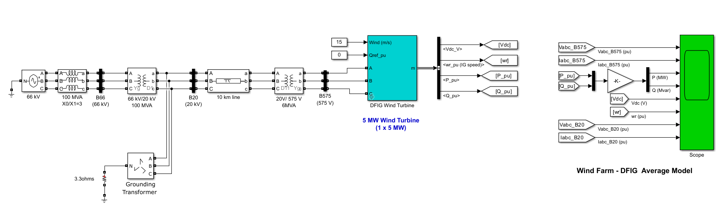
1-i. Block Scheme
Block Scheme of a 5 MW DFIG; Modified from [1] Gagnon, 2025

Slide 5
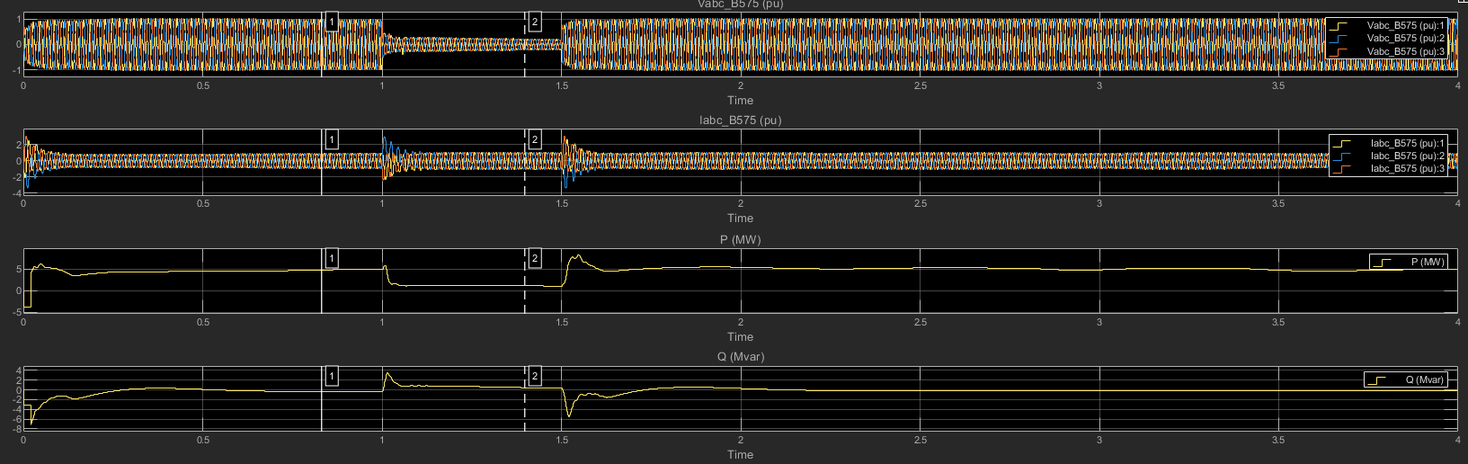
1-ii. Simulation Results
(Voltage, Current, active and reactive Power on the converter output; Created with Simulink; 12/10/2025)

Slide 6
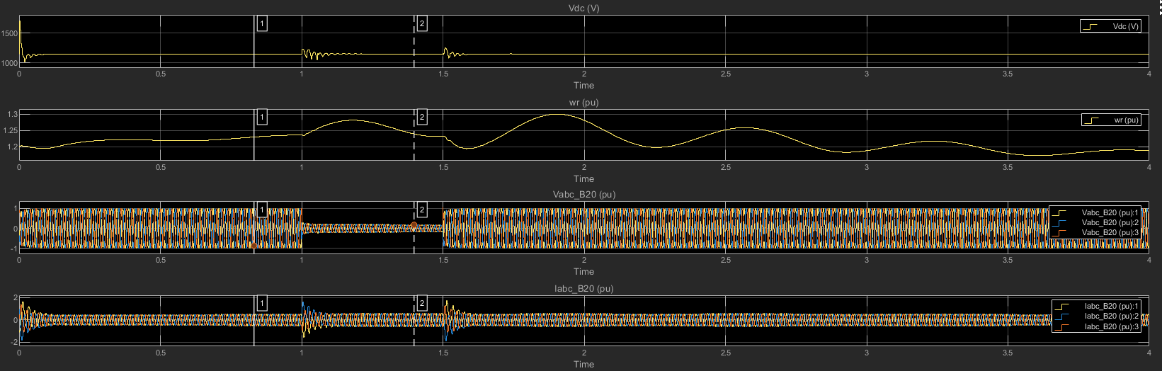
1-ii. Simulation Results
(DC-link voltage, rotational speed of the rotor, active and reactive Power on the grid side; Created with Simulink; 12/10/2025)

Slide 7
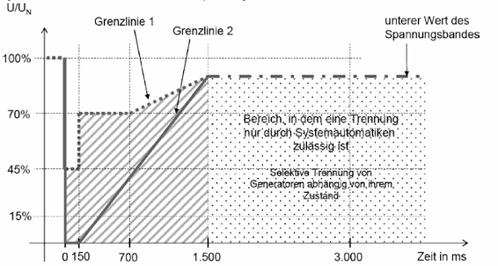
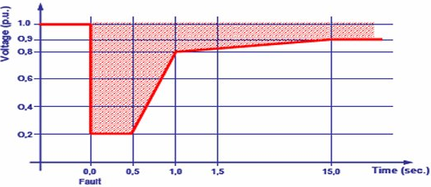
2. German vs. Syrian grid code
Voltage Profile Recovery of Wind Generators During and After a voltage sag; German grid code / E. O-Netz GmbH [2]; (11/10/2025)
Voltage Profile Recovery of Wind Generators During and After a voltage sag; Syrian grid code / PETE [3]; (11/10/2025)

Slide 8
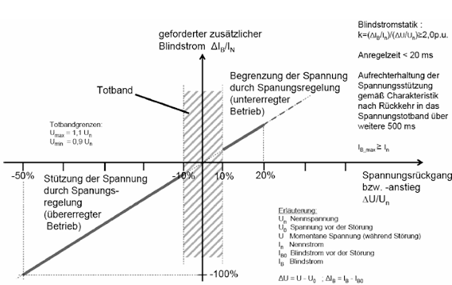
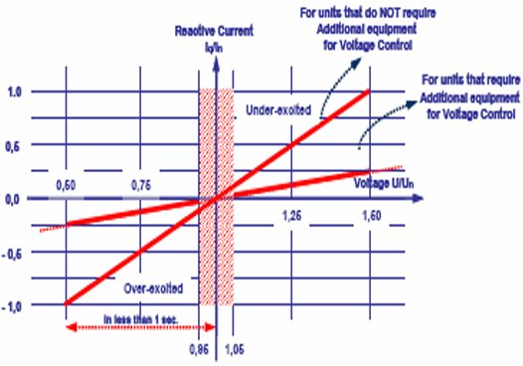
2. German vs. Syrian grid code
Minimum requirements for a non-synchronous machine in voltage control; German grid code / E.ON-Netz [2]; 2018
Minimum requirements for a non-synchronous machine in voltage control; Syrian grid code / PETE [3]; (11/10/2025)

Slide 9
3. Further work
More simulations in SIMULINK

Slide 10
Bibliography – Grid Code Development
[1] Wind Farm - Doubly-Fed Induction Generator (DFIG) Average Model. https://de.mathworks.com/help/sps/ug/wind-farm-dfig-average-model.html (accessed Oct. 12, 2025)
[2] E.ON-Netz GmbH / Grid connection rules for high and extra-high voltage. http://www.eon-netz.com/pages/ehn_de/Veroeffentlichungen/Netzanschluss/Netzanschlussregeln/ENENARHS2006de.pdf (accessed Oct. 12, 2025)
[3] SYRRIAN ARAB REPUBLIC / Ministry of Electricity / PETE / Transmission Grid Code, 2014 (accessed Oct. 11, 2025)

